Slide 1
Control Panel
Automation Panel, ASG
Product Manager, Chia Tu

Slide 2
What is Industry 4.0 target
Quality Assurance & Production Optimization
Value-added Service for Customer Satisfaction
Business Model Innovation & Revolution

Slide 3
Challenge in Industry 4.0
Production
Optimization
Value-added
Service
Business Model
Innovation & Revolution
Multi-information Displaying
Rich I/O, PCIe & mPCIe Support
Real-time control
Predictive Maintenance
Mass Customization
Flexible I/O Integration
Divergent Market Needs & Short System Developing Process
Notes:
How do we connect tens of or even hundreds, thousands of software and hardware from different systems? What kind of operating systems should be used?
How to control the sensor and feedback to the actuator in the real-time basis? How do we connect our ipc and tens of equipment with different connector interface?
How to create the robust environment to help our customer to download and upload data frequently and do the heavy analysis or even simulation in the cloud?

Slide 4
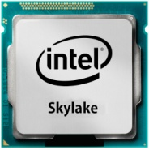
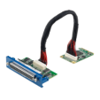
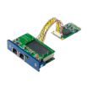
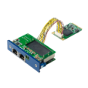
Automation Panels Strategy
Automation Panels Strategy
Modularized
Platform
Flexible I/O Integration
New CPU
Vertical
Solution
YESTERDAY’S MARKET
Develop products based on current market needs
Develop products with less customization
Develop Products with standard specification
TOMORROW’S MARKET
Develop products for every field
Develop Products with mass customization
Develop Products with modularize modules

Slide 5
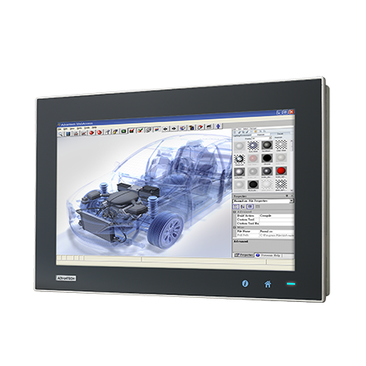
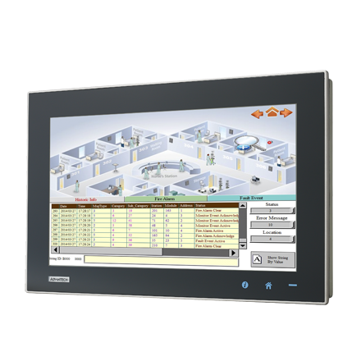
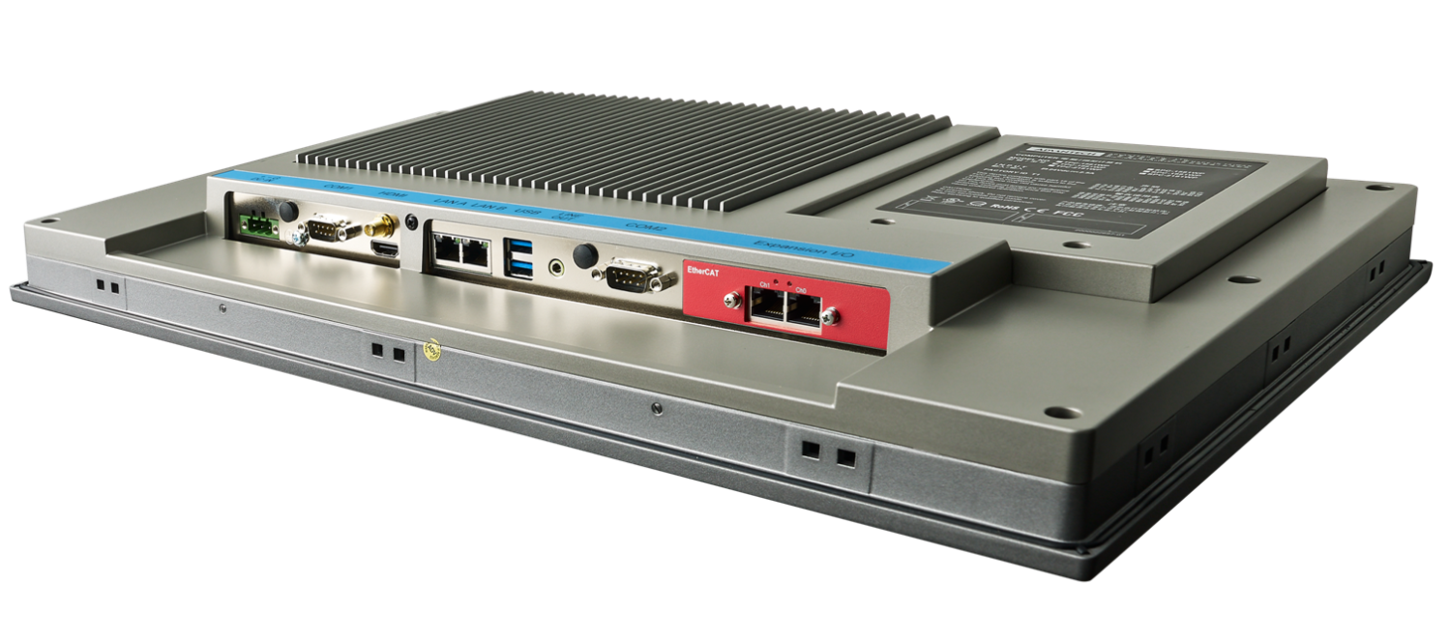
Maximized Performance
Rich I/O with Module Design
HW/SW Platform Supporting
Control Panel Series
The Burst Platform

Slide 6
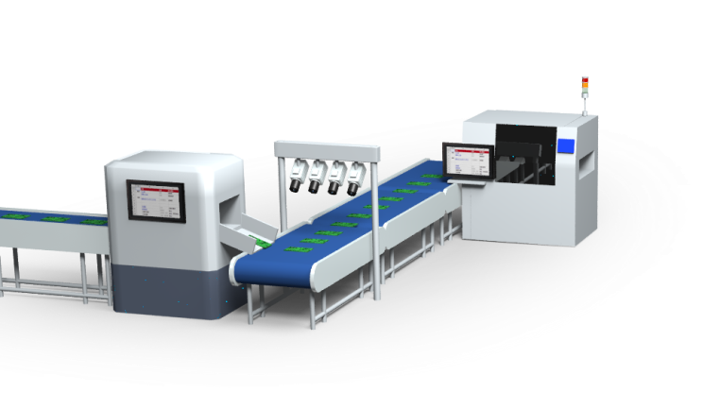
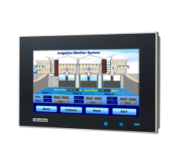
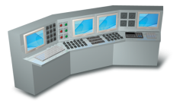
Target Application – High Performance Control
High Performance Computation
Ethernet Fieldbus Control
Real-time Data Analysis and Monitoring
Front Panel Interactive WiFi, Bluetooth and NFC Design
Win 7&10, Android and Linux OS Support
MES system, 3rd Software Connection (WebAccess Option)
Support Inter HD Graphics for HMI Display (WebAccess Option)
Equipment Status

Slide 7
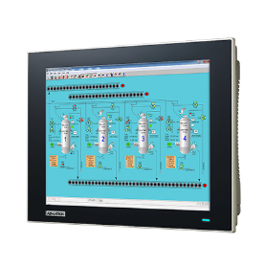
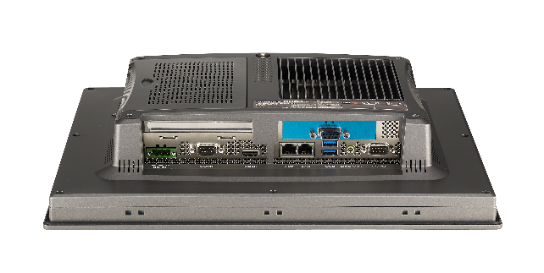
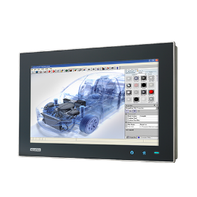
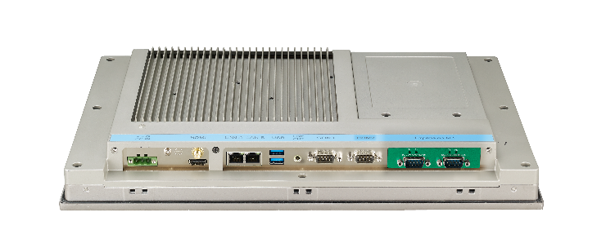
Overview - Control Panel Product Line
82H/T Series w/ PCIe
Classic Design
70/71 Series Best Fit
Intel Gen 4th Core Processors
Fanless & Power-Saving
4GB DDR3L (MAX 8GB)
iDoor & PCIe Expansion Built-In
Resistive Touch
True Flat / Bezel Screen
81WP Series w/ PCAP
Simple Style
Compact and Beauty
Intel Gen 4th Core Processors
Fanless & Power-Saving
4GB DDR3L (MAX 8GB)
iDoor Expansion Bulit-In
PCAP Multi Touch
True Flat Screen Design
Wide Screen

Slide 8
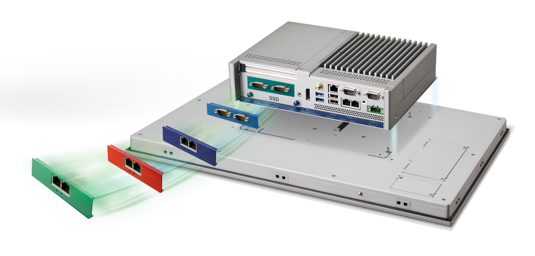
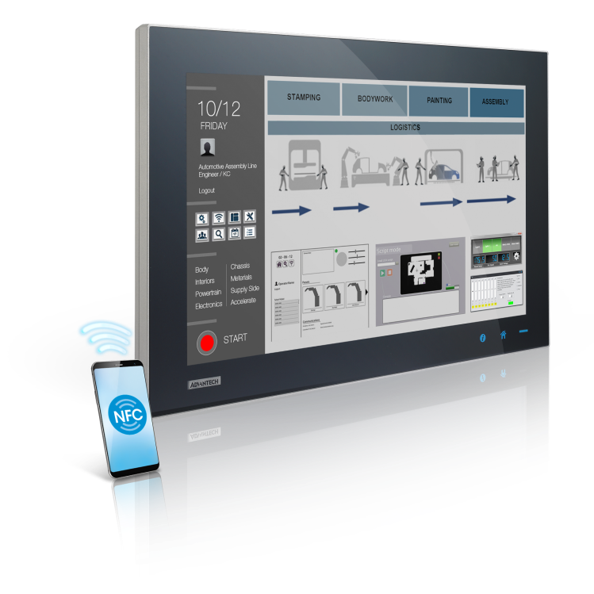
Overview - Control Panel Product Line
PCIe Slot
LAN x 3
Fieldbus / Teaming
Modular Design
Board to Board Connector
SSD
Front Accessible
Power Isolation
Noise filter Better reliability
TPC 5000 Modular Series
Intel Gen 6th Celeron, Core i3 or i7 CPU
4GB or 8GB DDR4 (MAX 16GB)
Rich I/O
iDoor & PCIe Expansion Built-In
True Flat Screen Design
Various Mounting Support

Slide 9
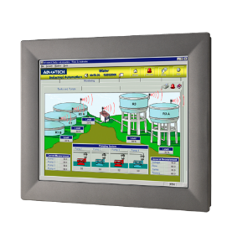
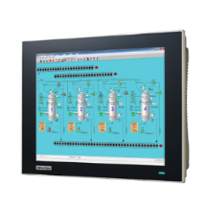
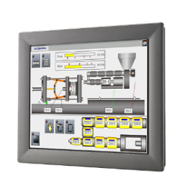
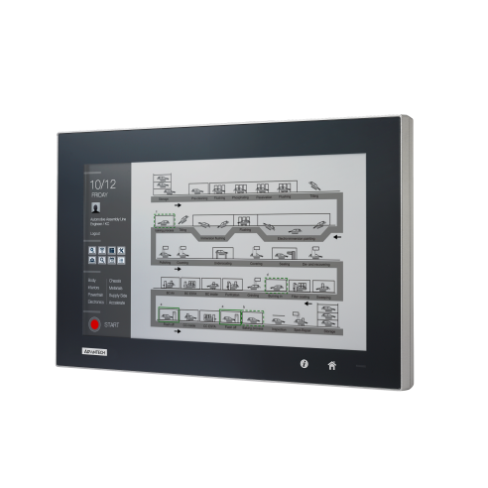
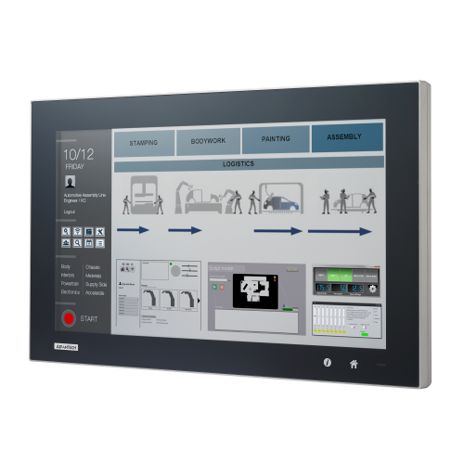
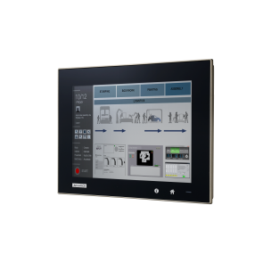
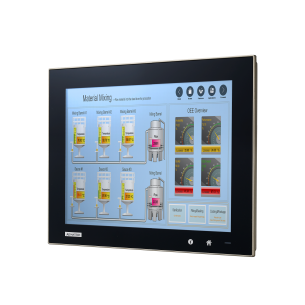
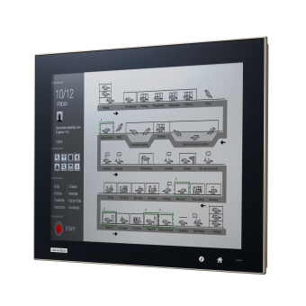
Overview - Control Panel Product Line
Classic TPC 81/82 Series
TPC-1282T
TPC-1582H
TPC-1782H
TPC-1881WP
New TPC 5000 Series
TPC-5122T
TPC-5152T
TPC-5172T
TPC-5182T
TPC-5212T

Slide 10
Main Features Highlight
Processer
Green
Robustness
Intel Gen 6th dual-core pcoressers
Extremely low system power requirement
Fanless design cover up to 50/55 degree operating temperature
Modularization
Integration
Interactivity
Independent 2.5” HDD bay / iDoor and multi-size panel support
Verifiied w/ embedded windows, Linux, CODESYS, WebAcess, RMM
iKey, iLink and Interactive WiFi, Bluetooth, NFC with Antenna Design
TPM 2.0
IEC Support
Compatibility
Control
Support TPM 2.0 Security Module to build more secure devices on both Windows and Linux
Rugged design with IEC 61010-2 and IEC61131-2 compliance
Same Cutout with previous generation Products

Slide 11
Multitasking – Aggregate Control Platform
Design
Drawing
Fieldbus
Communication
Scheduler
Vision
Cloud Data
Process
Process
Process
Process
Process
Control Panel Series
Multitasking Capability
Industry Field Bus
Multiple I/O
Operating System
Windows/Linux/Real time OS
Intel Core I Processors
High Performance
Low Power Consumption
CPU Core 1
CPU Core 2

Slide 12
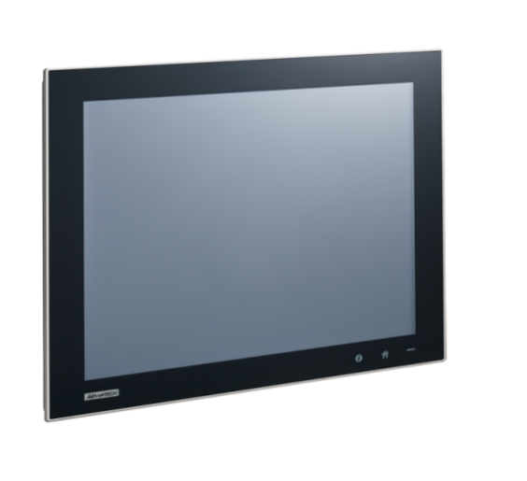
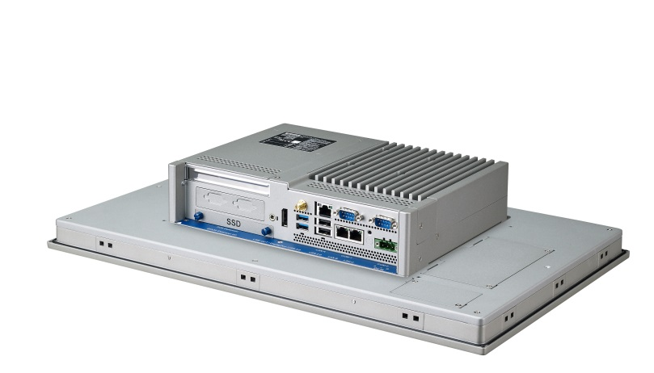
Fanless Design
Intel ULV CPU
Optimize thermal design
Lower power consumption
Fanless
Higher MTBF
Wider operating temperature
0~55°C
Robust Structure

Slide 13
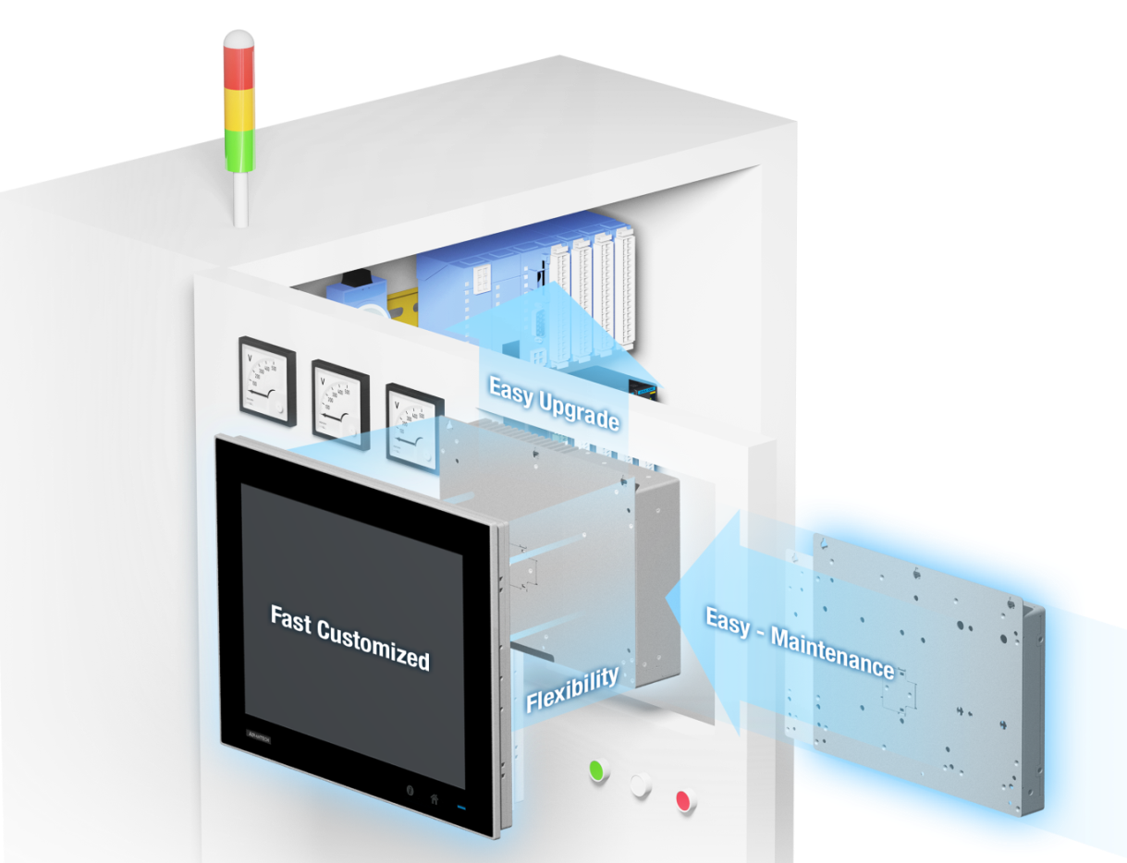
Why to be Modularized?
Flexibility
Three selectable box modules (Thin-client/Control Panel/Monitor) for different requirements.
Easy Maintenance
Maintaining the system simply removing the computing box. No need to unmount the whole unit from cabinet. And simply send out the defect module for repair.
Quick Customization
Touch designed to fast adapt to different logo requirements. Panel and box are in individual modules, faster to customize either one and adapt it to standard module.
Upgradable
Easy and economical replacement. Only need to upgrade computing boxes when technology advances.

Slide 14
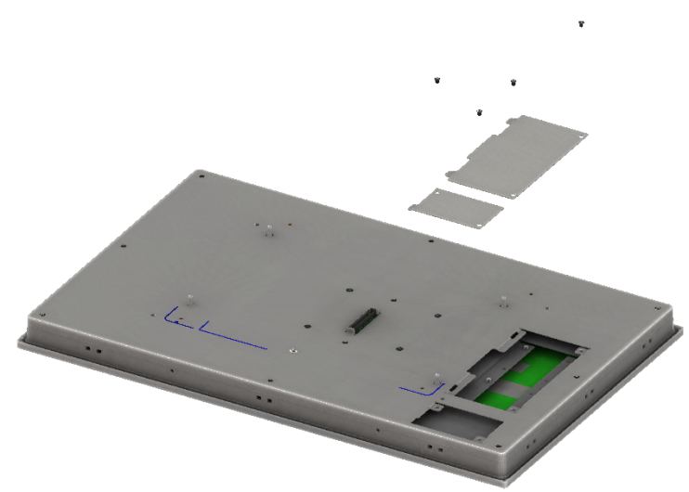
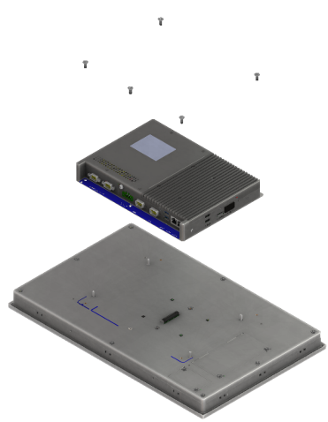
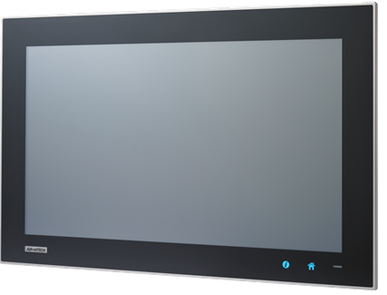
Easy Modularization
BOX Module
Optional Antenna integrated by 4 x screws
Display Module
Switch box and penal by 5 x screws
Wi-Fi / Bluetooth
NFC
Wi-Fi / Bluetooth Antenna
Wi-Fi / Bluetooth Antenna

Slide 15
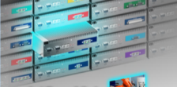
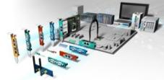
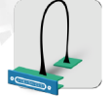
Simple, Flexible, Reliable by iDoor Technology
Standardization, Optimization & Integration
Various module & I/O plate w/ flexible customization
Easy for Replacement with different modules
iDoor diverse Vertical Application
Industrial Fieldbus
Communication
Smart I/O & Comm.
Multiple I/O & Peripheral
IoT
Data acquisition
Communication
iFactory
Machine control
Vision detection
Long distance display
Module
I/O plate
Standard Interface
81 mm x 19.4mm
Color identification

Slide 16
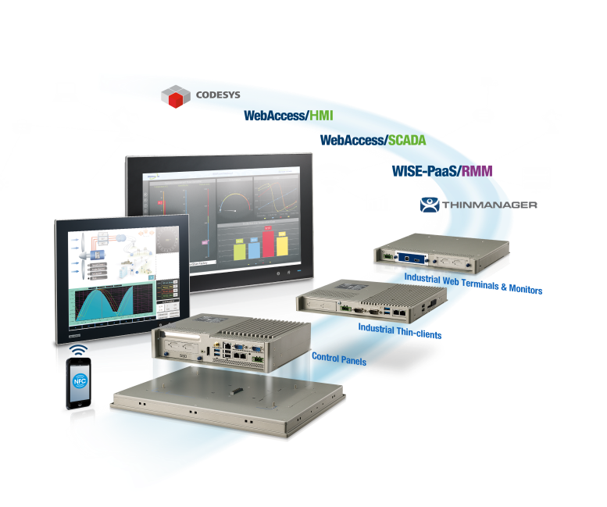
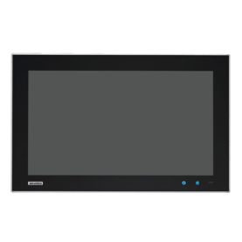
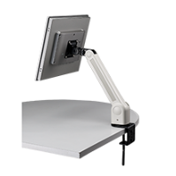
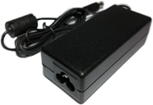
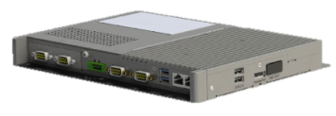
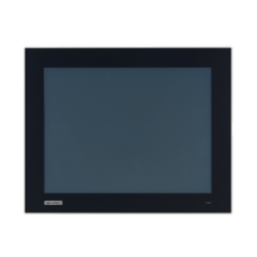
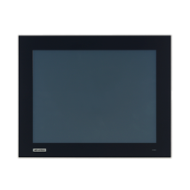
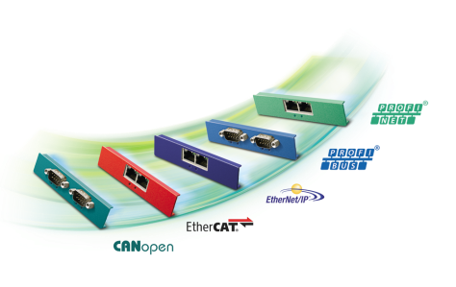
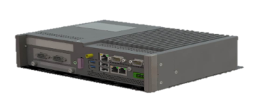
Module Selection Flow
 | Size | 12" | 15" | 17" | 18.5” | 21.5" W
Series | Module P/Ns | FPM-D12T-AE | FPM-D15T-AE | FPM-D17T-AE | FPM-D18W-AE | FPM-D21W-AE
TPC-2000 | TPC-B200-E12AE | TPC-2121T-E12AE | TPC-2151T-E12AE | CTOS | CTOS | CTOS
TPC-5000 | TPC-B500-673AE | CTOS | TPC-5152T-633AE | TPC-5172T-633AE | CTOS | TPC-5212W-633AE
 | TPC-B500-633AE | CTOS | CTOS | CTOS | CTOS | CTOS
 | TPC-B500-6C2AE | CTOS | CTOS | CTOS | CTOS | CTOS
FPM-7000 | FPM-B700-AE | FPM-7122T-RHAE | FPM-7151T-PHAE | FPM-7172T-PHAE | FPM-7182W-PHAE | FPM-7212W-PHAE
Function | HDMI (+USB) | DP (+USB) | iLink TX + RX | iLink RX
FPM I/O Module P/Ns | FPM-M700-HDAE | FPM-M700-DPAE | FPM-M700-TRAE | FPM-M700-RXAE
STEP 1
Box Module Selection
STPE 2
Panel Module Selection
STPE 3
Other Module Selection
FPM-7000
Cable & Adapter
TPC-2000
Mounting Kit
TPC-5000
12” / 15” / 17” / 18” / 21” Panel
iDoor Module

Slide 17
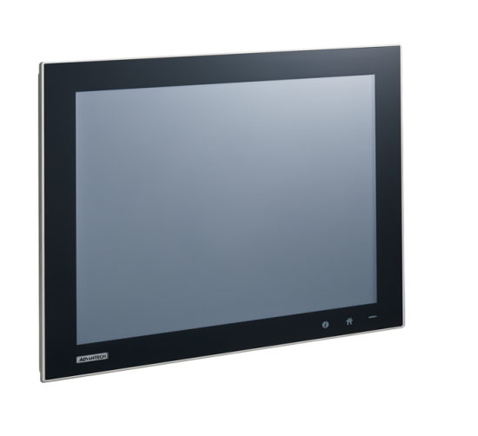
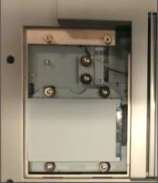
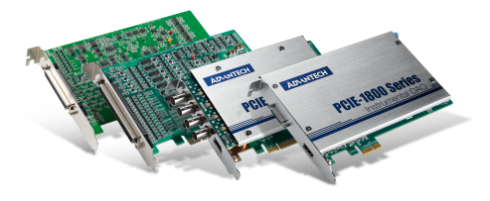
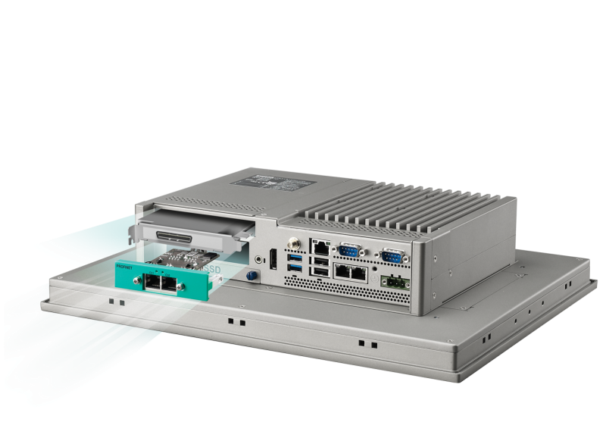
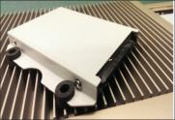
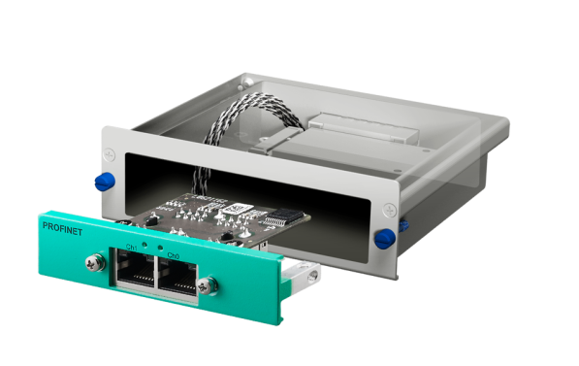
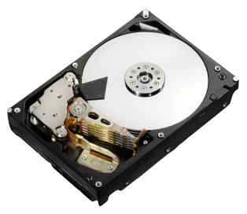
Modular HDD & iDoor Bay
Independent 2.5” HDD Bay

Slide 18
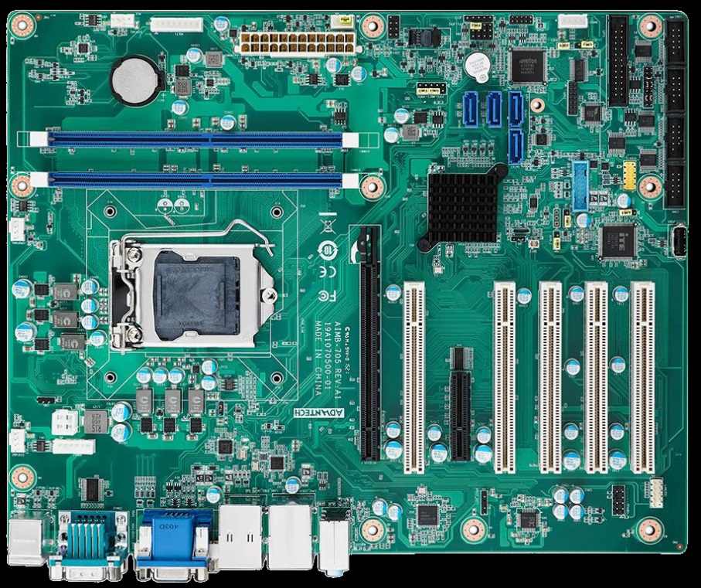
TPM – Trusted Platform Module
LPC connector
Benefit
Enhance confidence in platform
Binding of data to a particular platform
Owner privacy and control
Secure boot
Low cost exportable technology
Application:
1.Platform integrity
2.Disk encryption
3.Password protection
4.Digital rights management
5.Software license protection
6. Private medical and health information protection
7.Financial service provider
Trusted Platform Module for Data Encryption

Slide 19
TPM 2.0 Support
Answer to the growing Cybersecurity needs
- A cripthography of the information in an hardware view

Slide 20
Increasing Productivity and More Efficiency With Intuitive Operation of iKey
Shorten the Operation Layer, Information in Real-Time
More Efficient & Transparent in Machinery
Customized Keys for Intuitive Operation
I Key : Ctrl + Alt + Shift + I, H Key : Ctrl + Alt + Shift + H
GL Toolbar Utility

Slide 21
AP Switch in Automotive Industry

Slide 22
Innovative Display Module
Logo customization
iKey for on/off touch
Home key for application switch (customizable)
Optional NFC Reader
Wi-Fi Antenna on Front Bezel
NFC

Slide 23
Lower Price but
Superior Performance
TPC 5000 Series is the best replacement of 71H, 80H and 82H/T
Utilize Intel latest Core i Processer
Offering higher performance with affordable price.
Upgrade to i7-6600U!
5.6x up!!
4.5x up!
Model | CPU
5xxxT | I3-6100U
xx82H/T | I3-4010U
xx71H | Atom D525
xx80H | C2D L7400
3874
2.8x up!
2455
695
867

Slide 24
TPC & iDoor Success story
Country : Netherlands
Customer is a leader in cigarette and tobacco manufacturing. This project is about renewing their production line with a powerful system able to manage their new SCADA SW.
Customer Needs :
Customer needs to revamp existing plants managing existing installation. Fanless is a must and compact size is a winning solution allowing less efforts in installation. Plants are WW and a rugged device is needed to deploy without additional rework . Power consumption is an added value. iDoor allowed the flexibility to connect local I/O easily integrate in the system.
Volume : 500 x TPC-1582H + 500 x PCM-27D24DI + 200 IP54 enclosures

Slide 25
Process Control Application
MES system
Machine Control Monitoring
Production data storage
Production analysis
Process management
Interface with operator
Support Inter HD Graphics for HMI Display
Platform healthy Diagnosis - SUSIAccess
Via iDoor using Hilscher technology PROFINET
Non Vital senses
PLC for
safety tasks
Motion
control

Slide 26
*Model name is subjected to change
Control Panel Roadmap
Available
Developing
16:9
Wide Screen
TPC-1881WP
TPC-1581WP
TPC-5212W
TPC-5XX2W Series
21.5” TFT FHD LED LCD
Intel 6th Core i3, 8GB DDR4
True flat touch, IP66
Rich I/O & PCIe and mPCIe Slot
TPM / 3x GbE / MRAM option
Isolation Power design
iDoor support
Interactive WiFi, Bluetooth, NFC with Antenna Design
IEC-61010 -2 compliant
Modular Design
18.5”/ 21.5” Modularized Monitor Support
Intel 6th Core i7/i3, 8GB DDR4 or Intel 6th Celeron, 4GB DDR4
True flat touch, IP66
Rich I/O & PCIe and mPCIe Slot
TPM / 3x GbE / MRAM option
Isolation Power design
iDoor support
Interactive WiFi, Bluetooth, NFC with Antenna Design
IEC-61010 -2 compliant
Modular Design
15.6”/ 18.5” TFT HD LED LCD
Intel 4th Core i3 with 4GB DDR3
Multi-touch PCT and IP66 true flat
MiniPCIe Slot (iDoor support)
Q3,2017
4:3
Regular Screen
TPC-1282T
TPC-5172T
TPC-5152T
TPC-5XX2T Series
12.1” TFT XGA LED LCD
Intel 5th Core i3, 4GB DDR3
Rich I/O, PCIe and mPCIe Slot & iDoor support
15”/ 17” TFT SXGA LED LCD
Intel 6th Core i3, 8GB DDR4
True flat touch, IP66
Rich I/O & PCIe and mPCIe Slot
TPM / 3x GbE / MRAM option
Isolation Power design
iDoor support
Interactive WiFi, Bluetooth, NFC with Antenna Design
IEC-61010 -2 compliant
Modular Design
12” / 15” / 17” Modularized Monitor Support
Intel 6th Core i7/i3, 8GB DDR4 or Intel 6th Celeron, 4GB DDR4
True flat touch, IP66
Rich I/O & PCIe and mPCIe Slot
TPM / 3x GbE / MRAM option
Isolation Power design
iDoor support
Interactive WiFi, Bluetooth, NFC with Antenna Design
IEC-61010 -2 compliant
Modular Design
TPC-1782H
TPC-1582H
15”/ 17” TFT XGA/ SXGA LED LCD
Intel 4th/ 5th Core i3, 4GB DDR3
Rich I/O, PCIe and mPCIe Slot & iDoor support
Q3,2017
Released
2017 Q3

Slide 27
New Generation HMI Series
IoT Applications
BA
Oil & Gas
Water
Renewable Energy
Facility
Agriculture
Solution-Ready Packages
OS support
Soft Logic
SCADA/HMI
IT management
Value Added SW
Modularized
Intuitive operation
Long Distance
Latest Technology
Vertical Applied Panel
Operator Panel
Control Panel
Thin Client
Industrial Monitor
Optimized Platform

Slide 28
Automation Panel Product Family
Thin Client Terminal – TPC 51T/51WP/2000
Entry Panel computer for Automation Distributed Control System
Cost Effective solution with Simplify I/O
Compact design with Low power consumption
iDoor supported
Control Panel – TPC 82H/81WP/5000
High Performance Platform for Automation Controller
Robust Design with high reliability Standard
Field bus and communication by iDoor supported
Industry Monitor – FPM 2000/3000/5000/7000
16:9 wide screen display, PCT multi touch
i-Link technology for long-distance and daisy chain routing
Thin side bars and thinnest mechanical design in industry with IP65 protection
i-Keys for on screen display adjustment
Notes:
Remind you what we have ,

Slide 29
Automation Panel Product Family
Stationary Panel- SPC 40WP/81WP series
Standalone solution
All around IP65 with water proof M12 connector
Dashboard, information consolidation
Vertical Panel PC – IPPC-5211WS
Food & Beverage & Railway Market
The detachable product portfolio with accessories for various applications
Fanless cooling system and Support iKey / iDoor
Operator Panels – WOP-3000
RISC processors to satisfy the stringent standards required I
3.5"/5.7" /7”/10.1”/12.1” Die-cast aluminum alloy front bezel
Support wide operating temperature range
Notes:
Remind you what we have ,

Slide 30
Industry 4.0 Modular Panel Platform
5.7 ~ 21.5” size with 4:3 & 16:9 aspect ratio
Front IP66, True flat, P-Cap Muti-Touch
Logo Customization, LED and iKEY Tech.
Opt. Wi-Fi, Bluetooth, NFC Antenna Ready
Easy installation clip Design
Quick Box Customization
BOX Module
Display Module
Control Panel
Indu. Web Terminal & Monitor
Indu. Thin Client
TPC-5000
FPM-7000
TPC-2000
Control BOX Module
Optimized & Rugged Performance Housing Design
Latest generation of Intel® Core™ i processor
iDOOR & PCIe expansion & Removable SSD, M.2 & Antenna Design
TPM, MRAM, 3x GbE, isolation power design for control software compatibility usage
Panel Mount Supported
Terminal BOX Module
Compact / Slim / Modular Design
Slide in iDOOR+ Module in BOX
Low power RISC-Based web browser terminal
Opt. iDOOR smart i/o and communication module
Opt. multiple Video interface with Picture-in-Picture (PiP) functionality
iLINK Long distance (1to1 / 1to4)
VESA supported
Thin-Client BOX Module
Compact / Slim / Universal Design
Latest generation of Intel® ATOM™ Processor
Selectable iDOOR communication module and Removable M.2 storage
Industrial Wide temperature capability
PXE boot ready
Assets management enabled by WISE PaaS/RMM
VESA kit supported
Machine and Cabinet
Intelligent Data Acquisition
Process Visualization

Slide 31
New Generation of Control Panels
Optimized Design for iDoor
Comprehensive to support iDoor Modules
Build up two mPCIe slots to utilize iDoor selection and increase flexibility

Shaping Controlling Capability
Control

Build up image of control Panel
Upgrade spec from USB, LAN, CPU…
To advance product quality from thermal, reliability, compatibility(OS, HW, SW)
iDoor
Modularized Configuration

Modularized
Shorten product launch schedule
Increase product portfolio
Regional specialization in production

